Slide 1
Knowledge Graphs for RAG

Slide 2
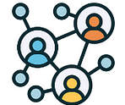
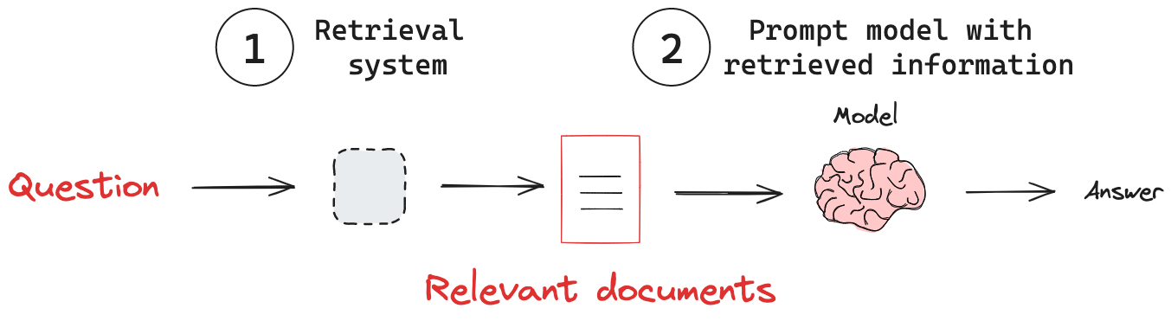
Knowledge graph
Notes:
I assume we all know at least the general idea about RAG, it is powerful for grounding LLMs with external data, to reduce hallucinations and overall improve generated output. But it’s limited: retrieval results are just chunks of text with no structure, making it hard to answer multi-step or exact questions. To fix some of this issues, we can replace the well-known vector storage with a knowledge graph.

Slide 3
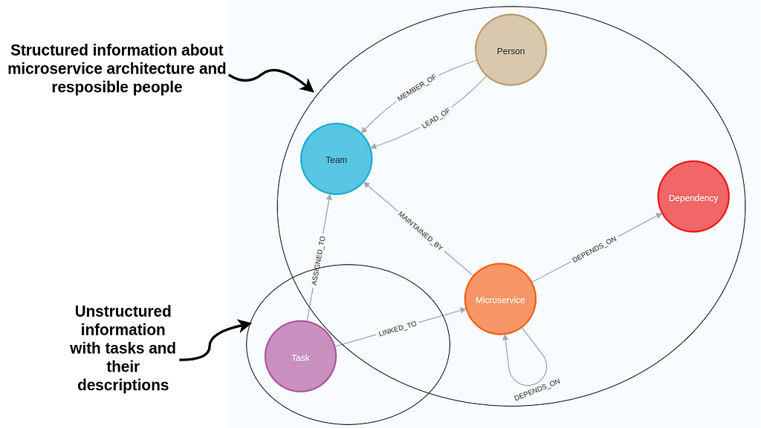
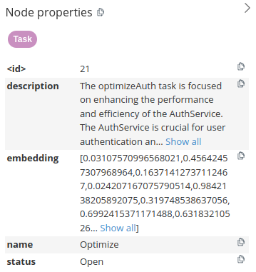
Knowledge Graphs for RAG
Notes:
Knowledge Graphs give us structured data with relationships. Store facts and their connections, and them retrieve them when needed.
Today we’ll explore how Knowledge Graphs can enhance Retrieval-Augmented Generation. I’ll explain why graphs add value over standard vector-based retrieval, and show some sort of a demo.
Let’s start from “What Is a Knowledge Graph?”
It’s obviously a graph, that captures information about data points or entities in a domain and the relationships between them. Data is described as nodes and relationships within a knowledge graph. Nodes represent data points or entities like people, organizations, and locations, whole edges represent relationships. In the microservice graph example, nodes describe people, teams, microservices, and tasks and relationships are used to define the connections between these entities, like dependencies between microservices or task owners.
Both nodes and relationships can have property values stored as key-value pairs.
And the cool part is that we can also store text embedding values as node properties allowing us to perform a vector similarity search the same way as if the tasks were stored in a vector database.

Slide 4
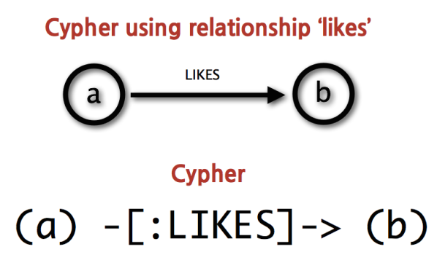
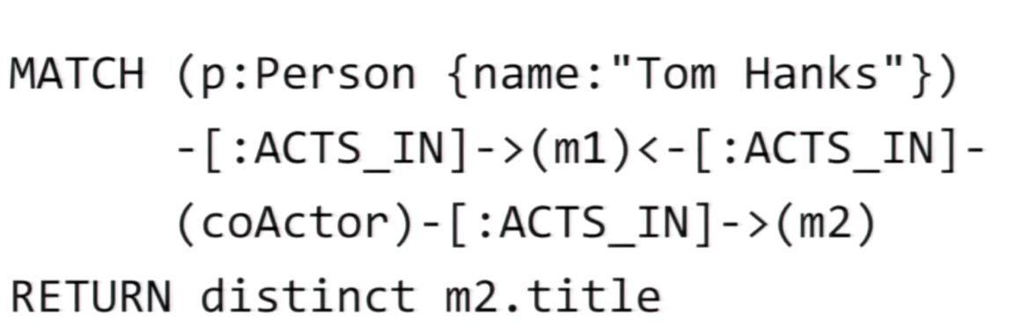
Notes:
In this workshop, we’ll query the database using a language called Cypher. Cypher is the standard query language for property graphs, especially in Neo4j, and it’s widely adopted. It works by describing patterns of nodes and relationships, and then matching those patterns against the data stored in the graph. While Cypher is the most common choice, there are also alternative graph query languages, so if you are interested you may also explore them. On the slide we see the example of query pattern…
It may seem pretty difficult to understand, moreover write one, but generally we won't need to, and i’ll explain why later

Slide 5
Regular RAG | KG-RAG
Vector DB only | Graph DB + embeddings
Retrieves similar text | Traverses entities + relations
No multi-hop | Multi-hop reasoning (A → B → C)
Black box recall | Transparent Cypher/SPARQL queries
Great for FAQs | Best for complex, analytical, regulated Qs
Notes:
Overall, advantages can be generalized to this table
KG-RAG is better in:
Structured/complicated exact answers (counts, filters, joins)
Multi-hop reasoning over connected facts
Explainability
Ontology-driven expansion (synonyms, hierarchies)
As a unified storage for structured + unstructured data
But, as in everything, there are always some obvious and no soo trade-offs:
Firstly there is Setup complexity: need schema design, KG construction, and maintenance (harder than just storing embeddings).
Then is Modeling overhead: like deciding what entities/relationships to include, and it often takes some domain knowledge.
Then there is Performance: graph queries can be slower and hybrid retrieval adds latency.
We can also mention Scaling: large graphs are harder to distribute than vector DBs.
I can also mention LLM reliability (but i’ll explain this later)
Overkill for simple Q&A: plain RAG is cheaper and faster if you don’t need multi-hop reasoning or explainability in a majority of solutions.

Slide 6
Use Cases
Existing tools
IT / DevOps → ownership, dependencies, open incidents
Customer Support → product → issue → solution linking
Cybersecurity → threat graphs, attack path analysis
Healthcare / Biomed → disease–gene–drug relationships
Compliance / Enterprise → policies, lineage, audit trails
Microsoft GraphRAG → improves discovery & aggregation across corpora
AWS Neptune GraphRAG Toolkit → graph-enhanced retrieval at scale
Neo4j + LangChain → tutorials, hybrid RAG with Cypher + embeddings
Cisco Outshift → guidance for enterprise AI reliability
Databricks → GraphRAG for manufacturing & security domains
Notes:
IT / DevOps Knowledge Assistants
Problem with plain RAG: A vector DB can retrieve “similar incident reports,” but cannot join facts (e.g., “which team owns the service with most open incidents”).
KG-RAG Encode services, teams, incidents as a graph → supports questions like: “Which services depend on AuthService?” “How many open incidents are linked to Team Beta?”
Value: Faster root-cause analysis, clearer ownership.
Customer Support & Product Knowledge
Problem: Customer asks about “laptop battery overheating issue.” A vector DB returns documents, but may miss related known issue → fix → product version chain.
KG-RAG advantage: Graph stores products, versions, issues, and fixes explicitly.
Cybersecurity
Problem: A SOC analyst wants to know: “What assets are at risk if CVE-2024-1234 is exploited?”
Vector-only: Might just pull text about CVE.
KG-RAG: CVE node → exploits vulnerability → affects software → runs on asset → belongs to system.
Value: Multi-hop reasoning across threat intelligence graphs; supports “attack path” discovery.
Healthcare & Biomedicine
Problem: A researcher asks: “What drugs target genes associated with Alzheimer’s?”
KG-RAG: Encodes relationships: Disease ↔ Gene ↔ Drug.
Value: Enables explainable biomedical Q&A with transparent paths, not just “text snippets.”
Already used in: systems like MedGraphRAG (for safe, evidence-grounded answers).
Enterprise Compliance & Governance
Problem: Auditors ask: “Which policies apply to customer data in EU systems?”
Vector-only: Returns some documents mentioning GDPR.
KG-RAG: Graph links policies → business processes → data assets → regions.
Value: Reliable, auditable answers with traceability — critical in finance, law, regulated industries.
These are the main domains where KG-RAG is especially valuable and often used.
And as you can see, it’s not just theory — Microsoft, AWS, Neo4j, Cisco, and Databricks already apply it in production.

Slide 7
🏢 Enterprise & Integration:
Digital twins (Siemens, Airbus)
Master Data, knowledge mgmt.
💊 Healthcare & Science:
Drug discovery, biomedical ontologies
Patient data integration
🔎 Search & Recommendations:
Google, Netflix, Spotify, Amazon, Alibaba
🧑‍💻 Assistants & NLU:
Siri, Alexa, Google Assistant
Entity linking (Wikidata, DBpedia)
📊 Business & Analytics:
Supply chain optimization
Customer 360°, compliance
📍 Social & Geospatial:
Social graphs (Facebook, LinkedIn)
Smart cities, IoT, event tracking
💳 Fraud & Cybersecurity:
Banking (AML, fraud detection)
Cyber threat intelligence
Notes:
And a quick sidestep, obviously KG is not only for RAG, but is already mainstream in industry.
Each area is backed by real-world products/companies that already use KG.

